Slide 1

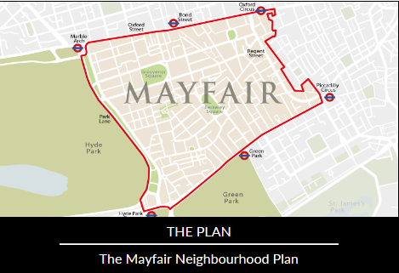
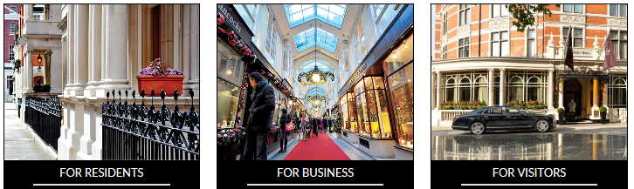
Annual General Meeting
26th April 2017

Slide 2

Agenda
Chairman’s report
Treasurer’s report
Neighbourhood Plan Update
Change of Chair
Elections
  Business Director
  Resident Director
Community Directors
Open Forum

Slide 3
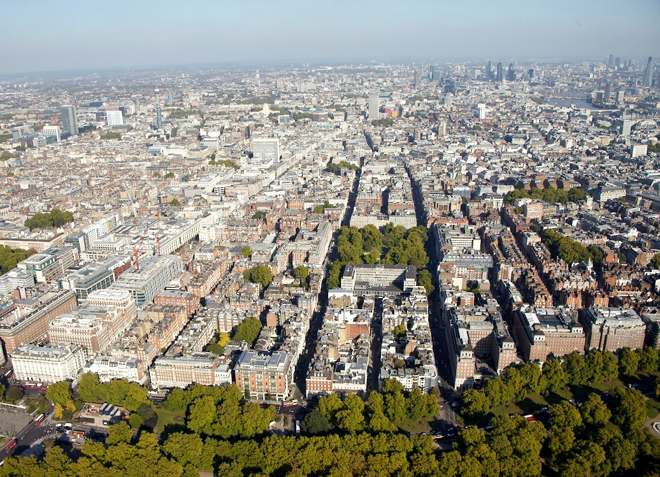
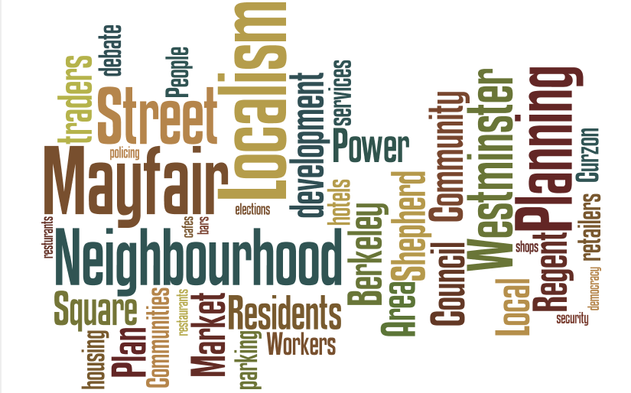
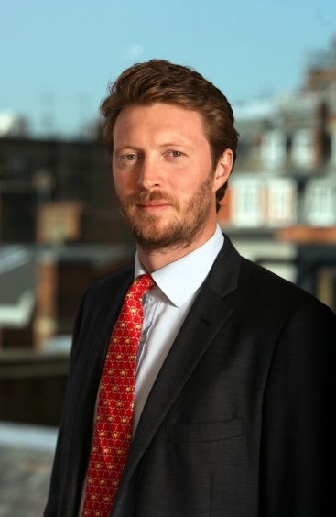
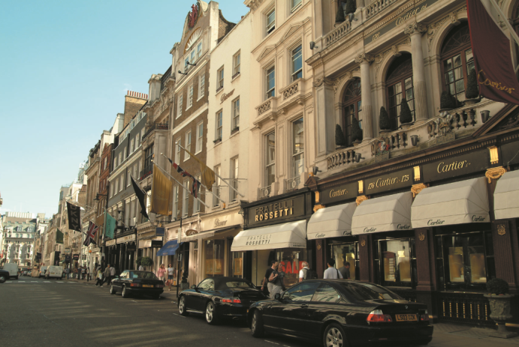
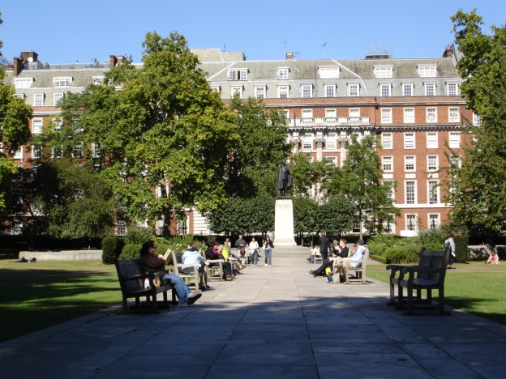
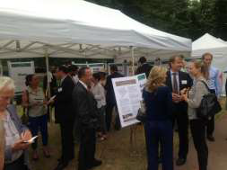
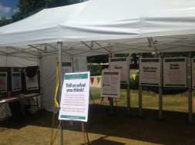
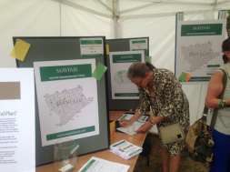
Chairman’s Report

Slide 4
Treasurer’s Report
Financial movement 01/04/16- 26/04/2017
Costs
Bank charges 25.04
Planning consultancy 11,144.74
Marketing and plan production 8,927.70
Total 20,097.48
Revenue
Groundwork UK grant aid 11,525.00
Knight Frank donation 5,000.00
Qatari Diar donation 5,000.00
Finchatton donation 5,000.00
Stow Securities donation 5,000.00
Savills donation 5,000.00
Maybourne Hotels donation 5,000.00
New West End Company donation 5,000.00
Total receipts 46,525.00
Net receipts 26,427.52
Starting period amount in bank 8,368.73
Closing amount in bank 34,796.25

Slide 5
Neighbourhood Plan Update
Planning Sub-Group
Drafting the Plan.
Meets on a monthly basis and reports to the Steering Group. Minutes will be made available on the website.
Comprised of:
Chair: Oliver Wright (Business Member and Head of Planning at Forsters LLP)
5 Resident Members (3 of whom sit on the Steering Group)
2 other Business Members (1 of whom sits on the SG)
1 professional advisor (planning consultant) – paid for by the MNF
Ad hoc attendance by additional professional advisors in a pro-bono capacity.
Oliver is supported by 2 members of the Forsters Planning team in an administrative capacity.

Slide 6
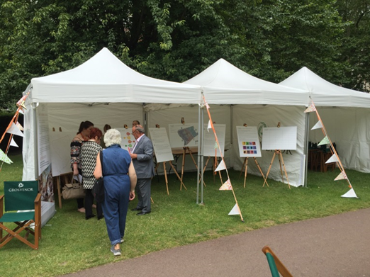
Neighbourhood Plan Update
Progress since April 2016 AGM
2016 Consultation
  Took place over 2 days in July in Grosvenor Square.
  Consulted on draft policy recommendations for the
  Plan.
  Feedback was supportive - 97% of the
  recommendations receiving a positive rating.
  2016 Consultation Report available on the website.
  Drafting of the Plan
  Commenced August 2016, with numerous iterations:
  Draft 1.1 (issued to SG 9 Sep 2016)
  Draft 2.0(issued to SG 23 Sep 2016)
  Draft 3.0 (issued to SG 7 Oct 2016)
  Draft4.0(issued to SG 30 Nov 2016)
  Draft 5.2 (issued to SG 3 Feb 2017)
  Draft 6.1 (issued to SG 3 Mar 2017)
  Draft 6.2 (issued to SG 8 Mar 2017)
  Draft 7.1(issued to SG 26 Apr 2017) and will be on website following AGM

Slide 7
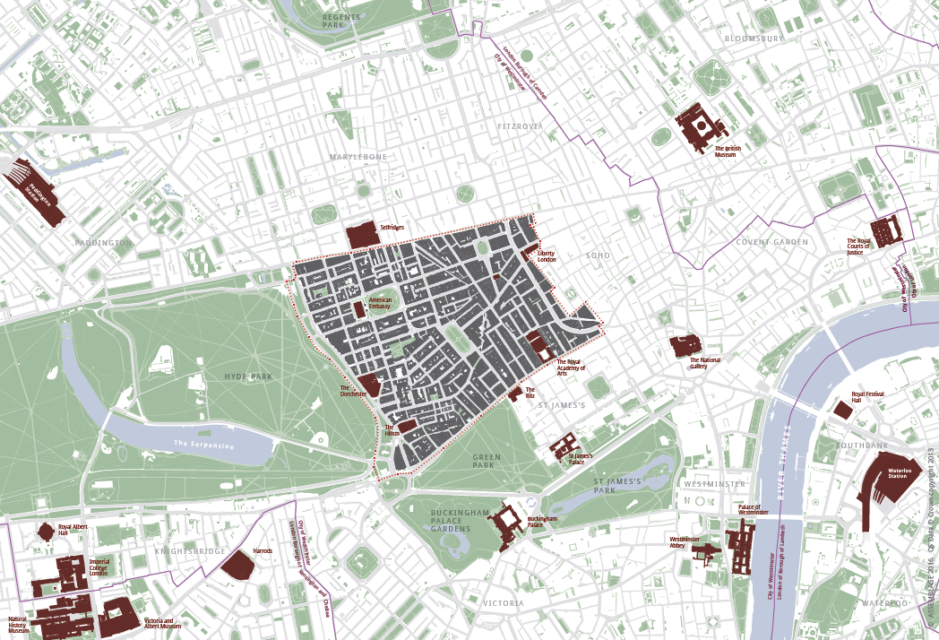
Neighbourhood Plan Update
Progress since April 2016 AGM (cont.)
  Plan currently stands at approximately
  130 pages.
  We have drawn in master-planning
  expertise to execute approximately 30 plans
  and maps to enhance the Plan.
  Enlisted professional publishers to issue the
  plan in “Mayfair standard” format.
  Each draft discussed at Planning Sub-Group and issues reported up to Steering Group.
  Draft 3 shared in October with Ron Whelan (MRG – and other MRG members), Lois Pelz (RSMSJ), and, by Lucy Whitcutt, to various residents on Bourdon St.
  Extensive one-on-one meetings with sub-committee members and SG members to discuss drafting.

Slide 8
Neighbourhood Plan Update
Stakeholder Meetings
Baroness Couttie (11 Nov 2016)
Westminster City Council (27 Apr 2016, 13 Sept 2016, 17 Nov 2016 & 1 Feb 2017)
TfL (11 Aug 2016 & 19 Dec 2016)
The Royal Parks (25 Jan 2017)
New West End Company (1 Aug 2016)
Heart of London (7 Sept 2016)
Regent Street Association (7 Sept 2016)
Peabody Estate (16 Jan 2017)
Other Neighbourhood Forums:
Belgravia, Victoria & Knightsbridge (16 June 2016, 18 July 2016, 12 Sept 2016 & 1 Nov 2016)
Marylebone, Soho, St James's, FitzWest (2 Mar 2017 & 7 Apr 2017)
Challenges and Opportunities
Allowing the people of Mayfair to direct planning policy in Mayfair
Balancing growth with the need to preserve and enhance Mayfair
Balancing needs and interests of residents, businesses, workers and visitors
Requirement to be in ‘general conformity’ with existing development plan policy (London Plan and Westminster’s City Plan) and national policy (NPPF and NPPG). One of the most challenging requirements. Also not repeating these policies.
Changes of use not requiring planning permission
Licencing / neighbourhood management as separate regimes

Slide 9
Neighbourhood Plan Update
Plan Summary
The Plan is divided into 3 main sections:
  Background:
    Summarising the history of the Forum and the plan process so far
    Setting out the vision for Mayfair (as approved in the 2015 Consultation)
    Detailing the current and emerging planning policy framework (“scene-setting”)
  Planning Policies:
  Subdivided into four main areas of focus:
    Transforming Public Realm
    Directing Growth
    Enhancing Experience
    Building on Heritage
  Priorities, Infrastructure, Management, Monitoring and Review:
  Neighbourhood management
  The application of Community Infrastructure Levy
  The ongoing monitoring and review of the plan for the future.

Slide 10
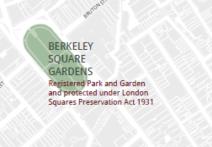

Neighbourhood Plan Update
Policy Summary
    Transforming Public Realm
    Public Realm:
    Seeking major developments to contribute to improving public realm.
    Setting out what principles should be followed when improvements to the public realm are proposed.
    Green Spaces:
    Protecting Mayfair’s green spaces for the use
    of the community.
    Seeking improvements to Mayfair’s green
    spaces from developments which front directly
    on to green space.
    Restricting purely commercial events.
    Green Infrastructure:
    Provision of new green infrastructure.

Slide 11
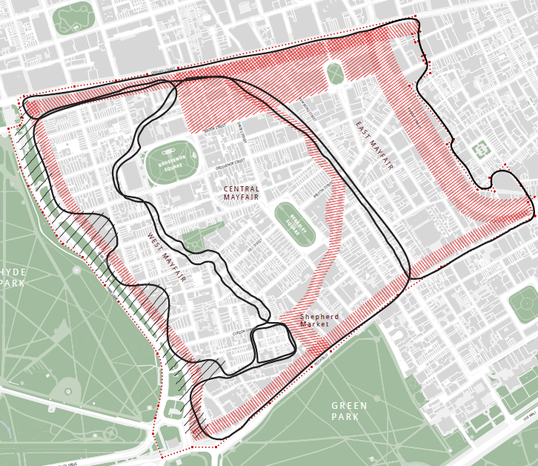
Neighbourhood Plan Update
Policy Summary
    Directing Growth
    Sustainable Growth:
    Ensuring that specific areas of growth are brought forward in compliance with the overarching themes of the Plan.
    “Growth” as defined by Plan, where appropriate, being mixed use, in: density, intensity of use, efficient use, amount of use, activity.

Slide 12
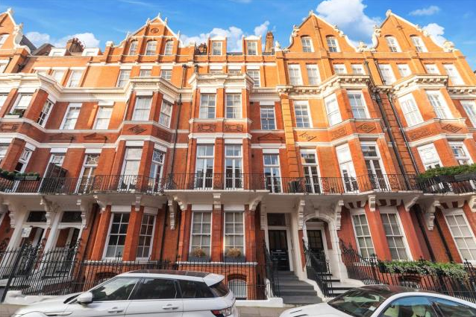
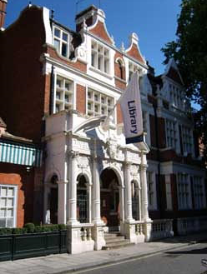
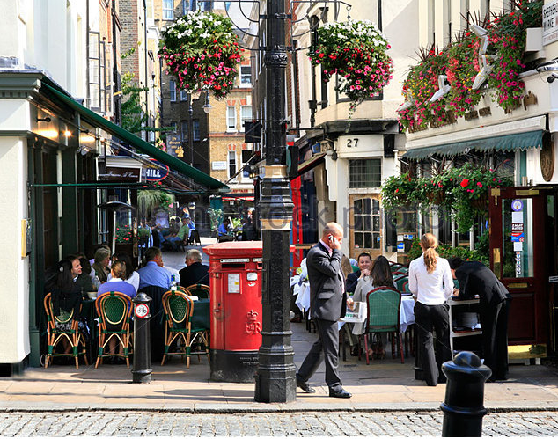
Neighbourhood Plan Update
Policy Summary
    Enhancing Experience
    Residential:
    Protecting residential amenity across Mayfair (see more next slide).
    Recognising West Mayfair as a predominantly residential area.
    Ensuring effective construction management.
    Shepherd Market:
    Preventing additional entertainment uses which would impact the character of Shepherd Market or result in harm to residential amenity.
    Social and Community Uses:
    Resisting the loss of any Social and Community Facilities or Public Houses.

Slide 13
Neighbourhood Plan Update
Evolution of residential amenity protection policy:
    Policy as per draft 7.1 (25.04.2017):
    “RU3: Proposals for new commercial or entertainment uses in Mayfair must demonstrate how they protect the amenity of nearby residential units and create no additional adverse effects (after mitigation) such as noise, and rubbish between 11pm and 7am.”
    Policy originally drafted as “Proposals for retail and entertainment uses will be supported where they complement and support the residential function and character of West Mayfair”.
    Changes:
    Proposals must now demonstrate how residential amenity is protected.
    This protection applies to the entire Mayfair area, not just West Mayfair.
    Policy relates to commercial and entertainment uses. Retail dealt with separately under retail specific policies.
    Approach made to Westminster City Council to seek comment on a draft version which would seek to completely restrict any new commercial or entertainment uses within streets which have a “predominantly residential use”.

Slide 14
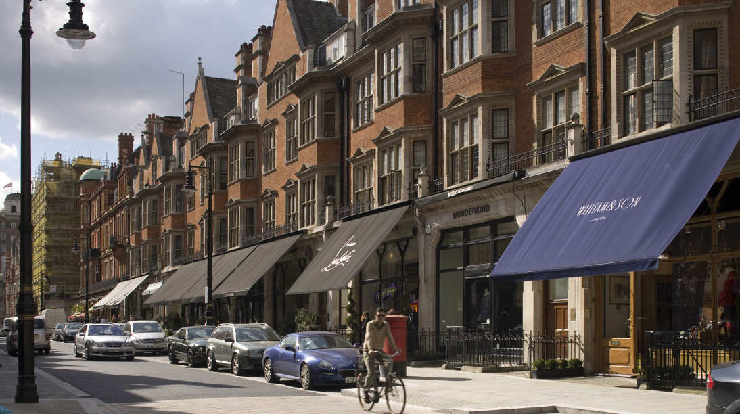
Neighbourhood Plan Update
Policy Summary
    Enhancing Experience (cont.)
    Retail:
    Identifying “Mayfair” shopping frontages where small-scale retail should be directed and protected.
    Resisting the loss of existing and encouraging the provision of new “local convenience” retail.
    Specifying improvements to the public realm around retail areas and identifying new “Oasis Areas”.
    Protecting uses which capture the essence of Mayfair retail.
    Further final agreement through discussion required on this.

Slide 15
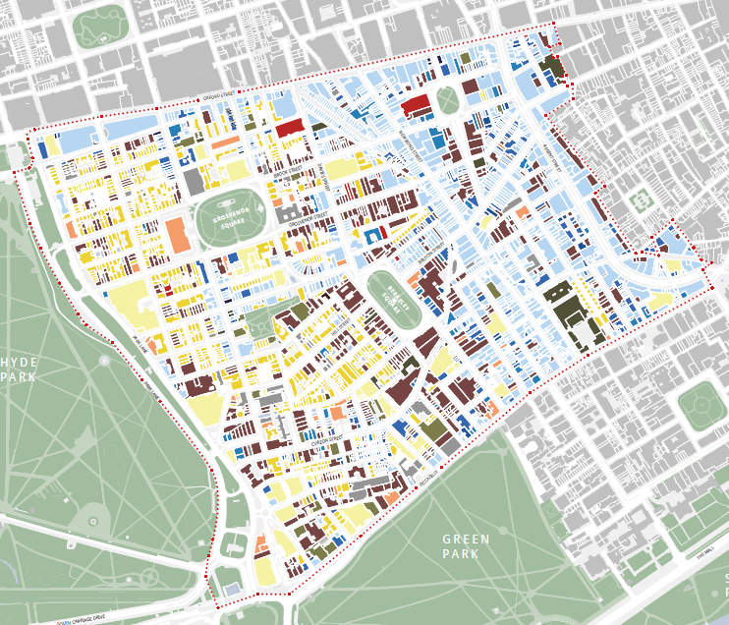
Neighbourhood Plan Update
Policy Summary
    Enhancing Experience (cont.)
    Commercial:
    Identifying Central and East Mayfair as appropriate areas for office and commercial uses.
    Resisting the loss of office floorspace in these areas.
    Ensuring all new development makes appropriate provision for the consolidation of deliveries, servicing and waste collection.

Slide 16
Neighbourhood Plan Update
Policy Summary
    Building on Heritage
    Design:
    Seeking high quality design which is appropriate for Mayfair in all new developments.
    Air Quality, Waste and Climate Change
    Seeking improvement to air quality through new development.
    Ensuring all new development has an operational waste management plan, including the use of waste consolidation and off-street collection points.
    Ensuring proposals are suitable for future climate change and compliance with the latest environmental build quality standards.
    Seeking all new developments to be Zero Carbon.
    Materials:
    Encouraging the recycling of all construction materials and seeking the use of sustainable and ethical materials.

Slide 17
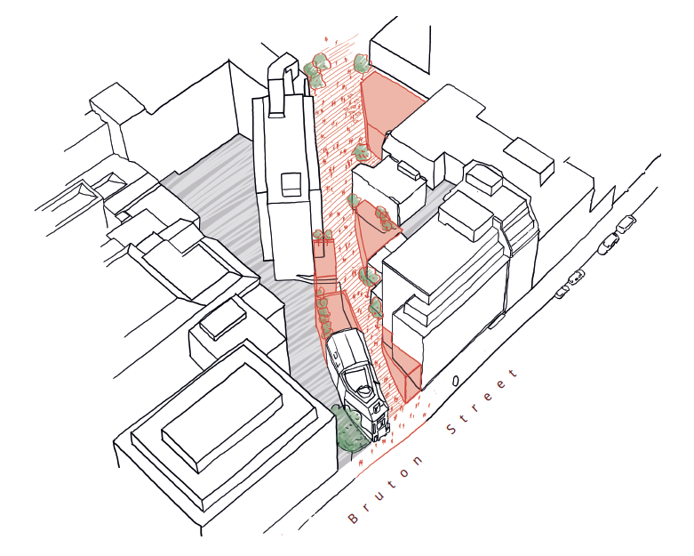
Neighbourhood Plan Update
Signature Enhancement Directions
    Park Lane:
    Revealing the possibilities for transformational change to Park Lane to improve the pedestrian experience.
Image: Courtesy of Liam Hennessey
    Tyburn Retail Opportunity Frontage:
    Identification of a new route through Mayfair to connect established retail with ‘backlands’ of Bruton Lane which could be enhanced.

Slide 18
Neighbourhood Plan Update
Future Timeline
May 2017
Final consultation text to be approved by the Steering Group
Full branding of consultation draft Plan
6 week public consultation commences
Special MNF Member presentation of the Plan
Submission of updated Plan (amended post consultation) to Westminster City Council
Westminster initiated 6-week consultation
Independent Examination of further amended Plan
Plan is “made” and becomes part of Westminster Planning Policy
Post Independent Examiner’s approval, simultaneous business and resident referenda
May 2017
9 June 2017
Christmas 2017?
Sept
2017?
29 June
2017
Spring 2018?
Summer 2018?
Autumn 2018?

Slide 19
Neighbourhood Plan Update
Presentation of the Plan
Notes:
FDR Mocked Up Chapter to be inserted here

Slide 20


Slide 21
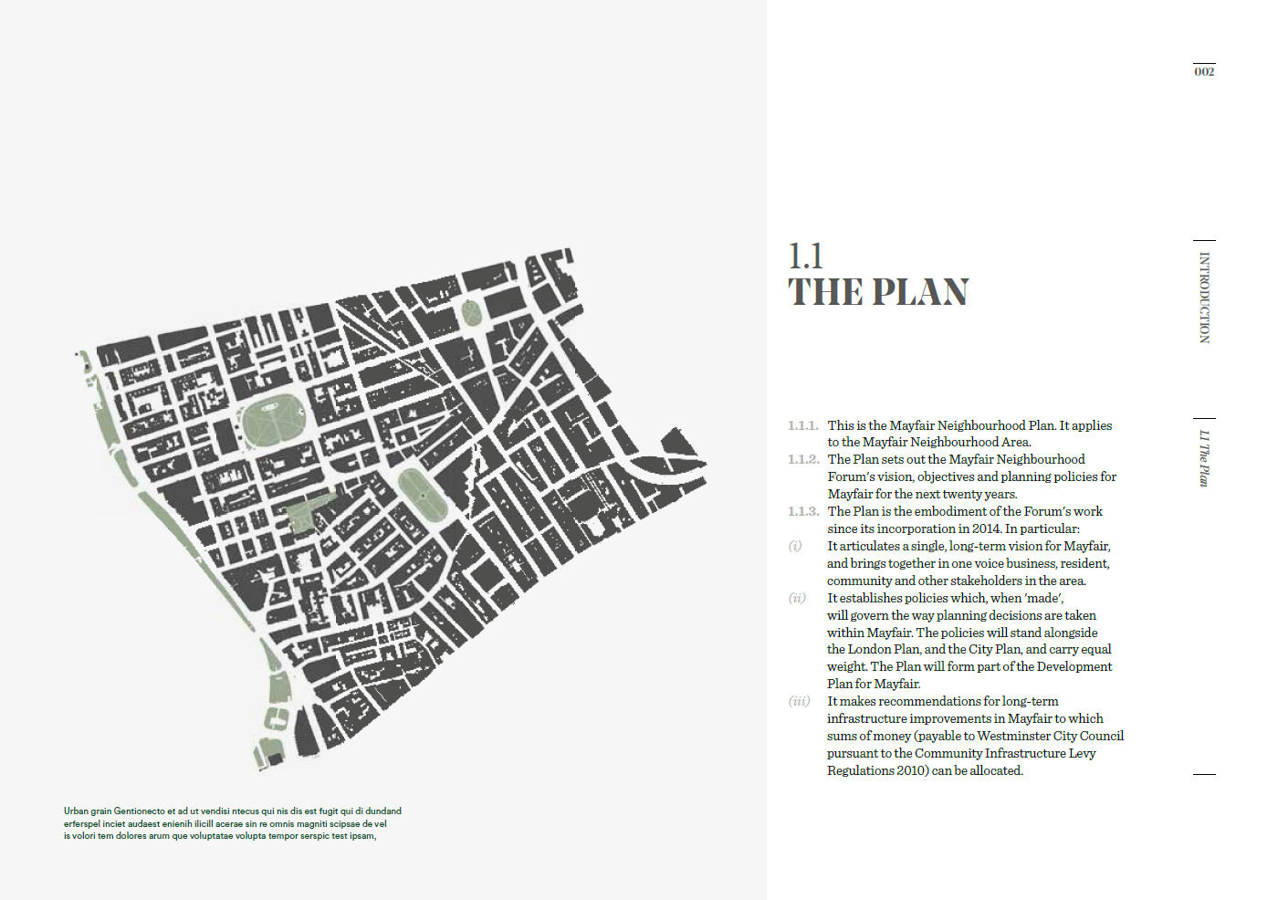

Slide 22
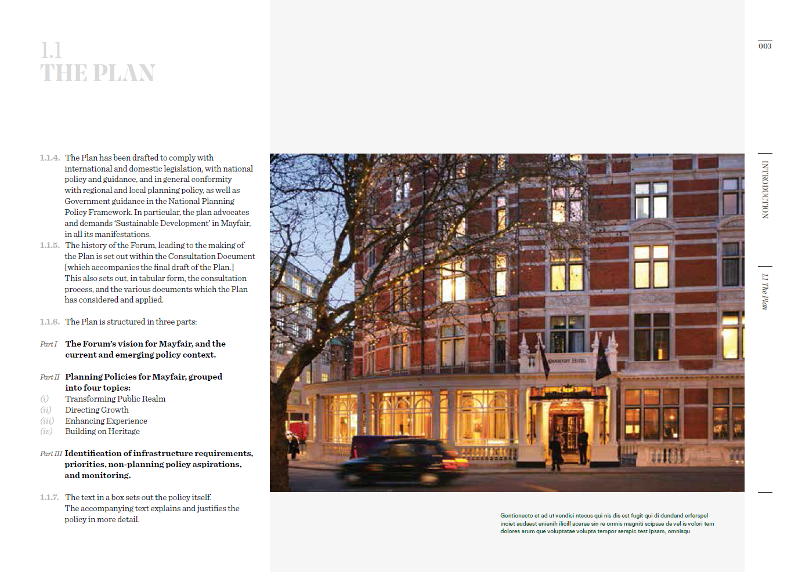

Slide 23
Neighbourhood Plan Update
What now?
    Publication of Plan to Forum Membership
    Draft 7.1 will shortly be available on the Forum’s website – www.mayfairforum.org
    When reading, be aware that the wording in bold is the planning policy itself. Other text is ‘supporting text’, and is background. This is explained further in the document.
    Exec summary will be prepared when all text settled – included in consultation draft.

Slide 24
Steering Group
Change of Chair

Slide 25
Election of New Directors
Resident Director:
George Hammer
Diana Dennis
Business Director:
Debbie Flevotomou
Jace Tyrell
Lucy Whitcutt

Slide 26
Community Directors
There are two additional vacancies for Community Directors.
The Steering Group would like to invite expressions of interest for consideration, which can be made at any time. Community directors are appointed by invitation of the Steering Group and will be considered by the new Steering Group after the AGM.
In order to be eligible, a Community Group Director must be a:
"Representative of any organisation (whether incorporated or not) which primarily operates for the benefit of the Mayfair Area community as a whole, including operations such as (inter alia) places of worship, libraries, health facilities, public buildings, open space facilities, education facilities together with not-for-profit representative groups which exist to promote or monitor community assets or functions” (Article 16.1).

Slide 27
Open Forum

